Slide 1

Chapter 1 Clean Code

Slide 2
Bad Code, Why?
Reach deadlines
No enough time to do a Good job!
Your boss will be angry if you take time to clean up your code
Tired and just want it to be over
Notes:
The managers and marketers look to us for the information they need to make promises and commitments
It is unprofessional for programmers to bend to the will of managers who don’t understand the risks of making messes.
- You will not make the deadline by making the mess. Indeed, the mess will slow you down instantly, and will force you to miss the deadline.

Slide 3
The Grand Redesign in the Sky
Mess piles up and productivity => zero
Tiger team selected
3. Maintain current system until new one is ready
4. Redesign new system, it's such a mess!!
Notes:
- two teams are in race, tiger team must build everything that old system does
meanwhile keeping up with changes that are continuously being made to old system
- it takes long time for both teams to reach focal point

Slide 4
What is clean code
Clean code is pleasing to read
Bad code tempts the mess to grow !
Bjarne Stroustrup
Inventor of C++
Notes:
When others change bad code, they tend to make it worse.

Slide 5
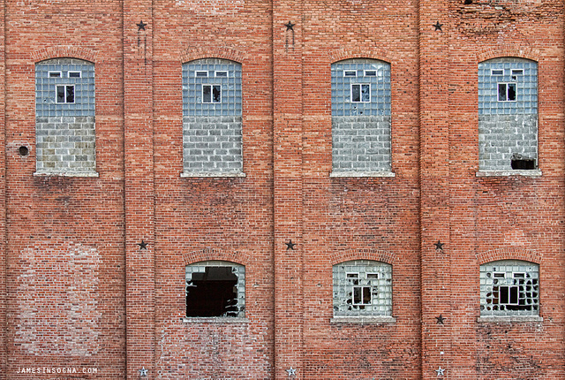
Broken window theory
Notes:
A building with broken windows looks like nobody cares about it. So other people stop caring.

Slide 6
What is clean code
Our code should contain only what is necessary
Clean code should read like well-written Novel
Grady Booch
Author of OOP

Slide 7
What is clean code
Clean code makes it easy for other people to enhance it
Smaller codebase the better
Dave Thomas
CEO of Eclipse project

Slide 8
What is clean code
Duplicate code is a sign there is an idea in our mind that is not well represented in the code
Ron Jeffries
Extreme Programming in C#
Notes:
beautiful code makes the language look like it was made for the problem.

Slide 9

The Boy Scout Rule
Leave the campground cleaner than you found it
Change one variable name for the better
Break up a function that’s a little too large
Eliminate small bit of duplication
Clean up one composite if statement

Slide 10
Vocabulary: Coding style
Set of rules or guidelines to write and read code
Help teams to understand each other’s code
Reduce conflicts on source control and enhance code review
Quizlet
C# coding styles
Notes:
Show them C# coding style guides at Microsoft docs
https://git.ir => clean code videos

Slide 11
Tool: Lint checker
Static code analysis tool
Perform quality check on your codebase
Can be configured on your IDE
Examples lints: deprecations, new apis, security, performance, …

Slide 12
Thank You!

